Slide 1


Ten tips for using path analysis in IPM and biocontrol research Robert Clark, Emily Rampone, David Crowder
Presented by: Robert Clark
Data Scientist @ Ecodata.tech | Affiliate Faculty @ WSU
ESA Vancouver 2022, November 13rd

Slide 2
Quick outline
What problem does path analysis solve in entomology research?
What is path analysis?
What are the drawbacks of path analysis (and what do you do)?
Ten rapid-fire examples

Slide 3
A reasonable model to the novice analyst…
Yield ~ natural enemies + pest herbivores + herbivory

Slide 4
Correlations between predictor variables creates many headaches
Yield ~ natural enemies + pest herbivores + herbivory
Problem: Model violations aside, you will get p-values that are very misleading or confusing

Slide 5
You say to yourself: “How the hell could crop damage not impact yield?!”
Yield ~ natural enemies + pest herbivores + herbivory
Example GLM output:
Natural enemies: P = 0.06
Pest herbivores: P = 0.001
Herbivory: P = 0.7

Slide 6
You say to yourself: “Let’s check”
Yield ~ crop damage
Example GLM output:
Herbivory: P = 0.001

Slide 7
You say to yourself: “Let’s put natural enemies back in”
Yield ~ natural enemies + crop damage
Example GLM output:
Natural enemies: P = 0.01
Herbivory: P = 0.001

Slide 8

You say out loud: “Statistics are ridiculous.” “I’m not good at R.” “I can’t believe we spent 2 years collecting field data and we can't even get a model that makes sense and maybe I should just add a random effect or something but I'm not quite sure what those really are even though a reviewer said we should be using them.”

Slide 9

A postdoc helped me through this exact problem when I was a graduate student

Slide 10
Path analysis (SEM) in a nutshell: Split this large model into smaller pieces
1. Yield ~ natural enemies + pest herbivores + herbivory
1. Pest herbivores ~ Natural enemies
2. Herbivory ~ pest herbivores
3. Yield ~ crop damage

Slide 11
Path analysis (SEM) in a nutshell: Order the models based on cause & effect
Natural enemies
1
Pest herbivore
1. Pest herbivores ~ Natural enemies
2. Crop damage ~ pest herbivores
3. Yield ~ crop damage
2
Herbivory
3
Crop yield

Slide 12
Path analysis is most powerful when used as a tool for quantifying indirect effects (which are often more important than direct effects)
Natural enemies
1
Pest herbivore
1. Pest herbivores ~ natural enemies
2. Crop damage ~ pest herbivores
3. Yield ~ crop damage
2
1 x 2 x 3
Crop damage
3
Crop yield

Slide 13

A love-hate relationship with path analysis since 2016
Path analysis

Slide 14

Limitation 1
You must know what the direct and indirect effects could be ahead of time

Slide 15
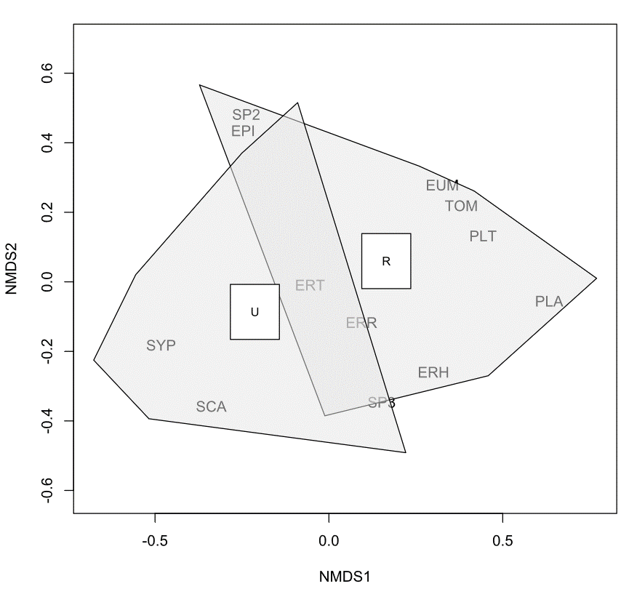
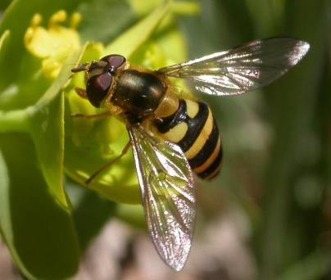
Limitation 1 solution
NMDS or other ordination techniques are better for exploratory analysis
Urbanization restructured the pollinator community
Olsson, Brousil, Clark, Baine and Crowder (2021) Food Webs

Slide 16

Limitation 2
Path analysis makes unidirectional, causal assumptions

Slide 17
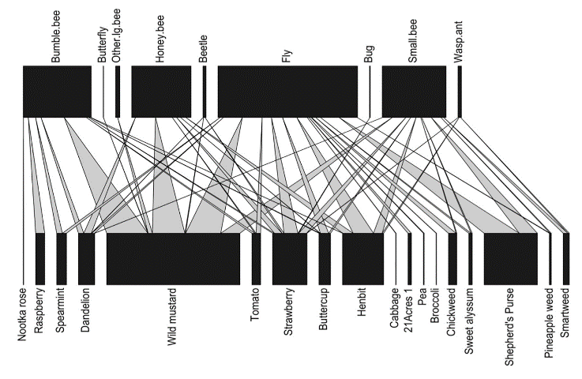
Limitation 2 solution
Network analysis is superior for open, bidirectional networks
Example bipartite network from Olsson, Brousil, Clark, Baine and Crowder (2021) Food Webs

Slide 18
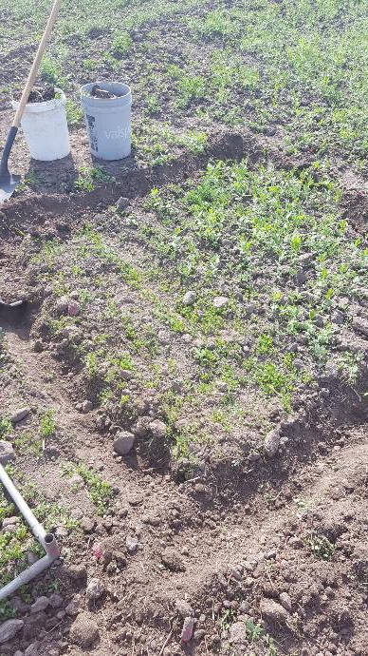
Limitation 3 + 4
3. Categorial variables with a larger number of levels “work” but it’s a hassle to interpret
4. Interaction terms cause the same problem
Vetch edge
Clover
edge
Pea
monoculture
X
X
Natural enemies present
Natural enemies absent
X

Slide 19
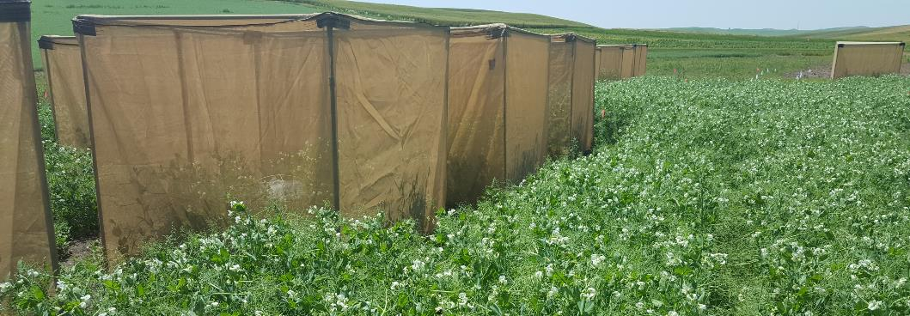
Limitation 3 + 4 solution
Stick with linear mixed models and retain the terminal effect of interest (e.g. yield)
A Generalized Linear Mixed Model that examines complex treatment effects and random effects should look at the most important response variable (yield, disease, etc.)

Slide 20
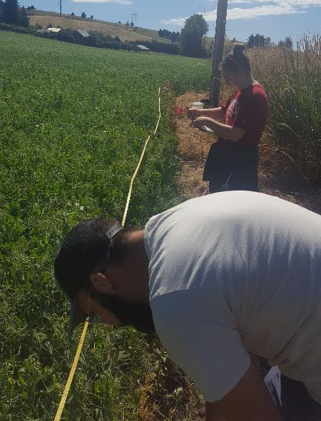
Limitation 5
Overfitting is still just as problematic if you have large surveys and lots of hypotheses
Caused by adding too many predictor variables and random effects (weather, elevation, host-plants, etc.)

Slide 21
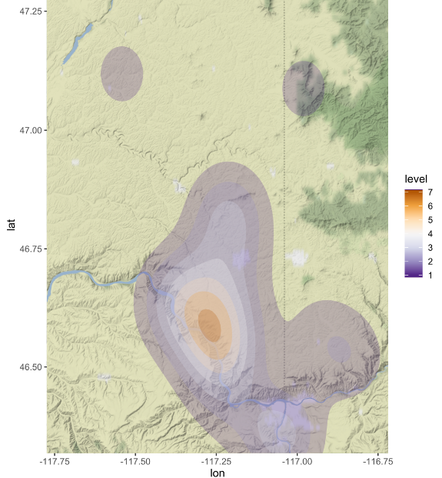
Limitation 5 solution:
Washington
Idaho
I see this problem most often with landscape scale surveys
Multivariate stats (MANOVA) with model selection are recommended instead
Snake River

Slide 22

Limitation 6
Visualization of path diagrams is time consuming and not easily automated
Predators
PEMV
Positive effect on aphid abundance
Negative effect on aphid abundance
Fava
Lentil
Predators
PEMV
Pea
Vetch
Clover
PEMV

Slide 23
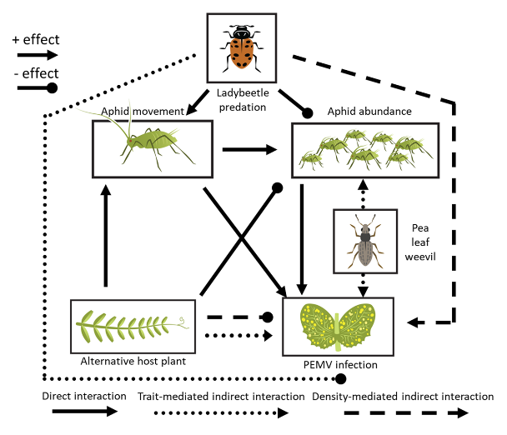




Limitation 6 solution: Work with a scientific illustrator
Ladybird presence
-
Weevil presence
+
Vetch
Source
Aphid #
+
+
Viral RNA presence

Slide 24
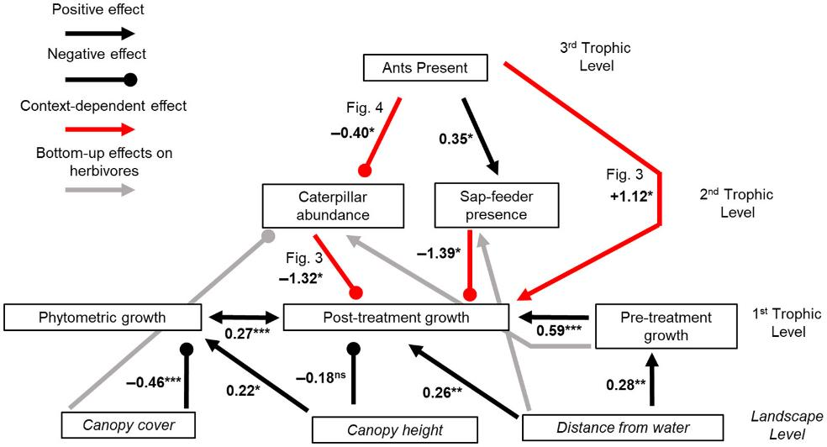
Limitation 7
Drawing too many indirect effects will confuse your audience

Slide 25
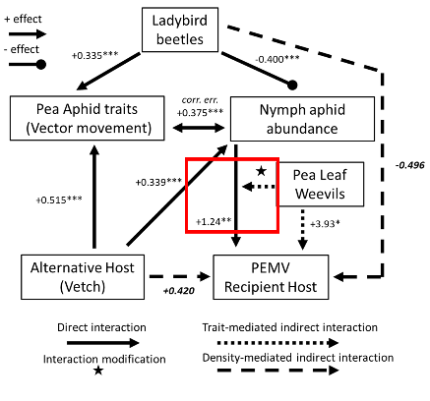
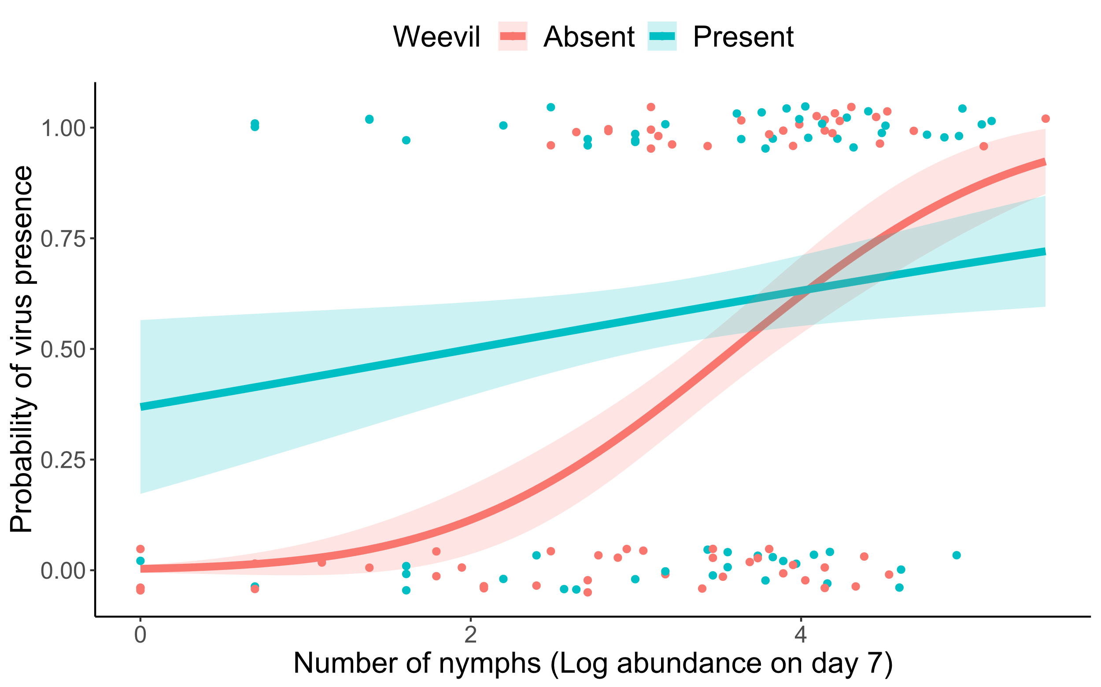
Limitation 7 solution: draw these indirect effects as separate figures or analyses

Slide 26
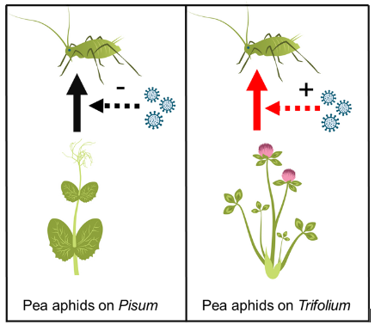
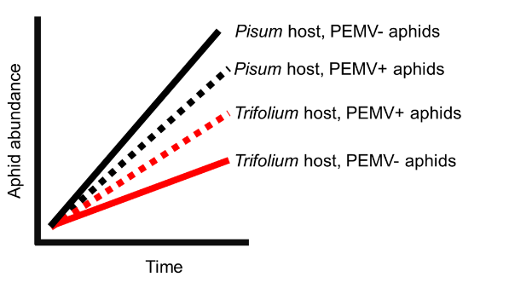
Limitation 8
Scaling coefficients to make system-wide comparisons has drawbacks, especially if you need to know exactly the effect size of certain treatments

Slide 27
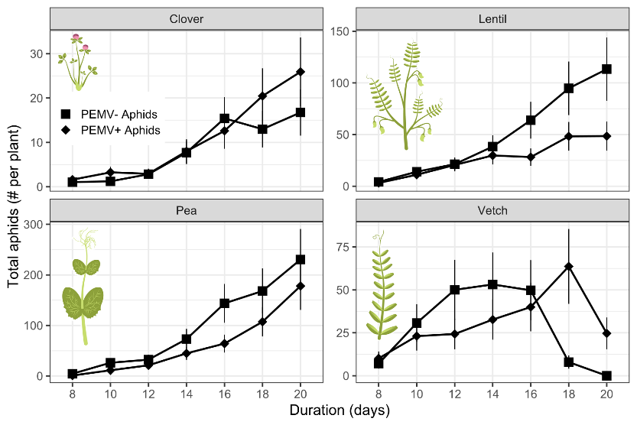
Suggested solution to Limitation 8: Drop SEM entirely

Slide 28
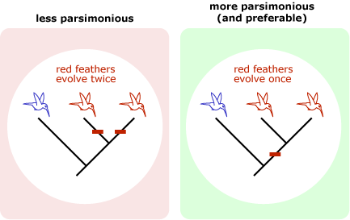
Limitation 9
Path analysis tells you if your path diagram is valid, not if it’s the “best” (or not if its the most parsimonious)

Slide 29
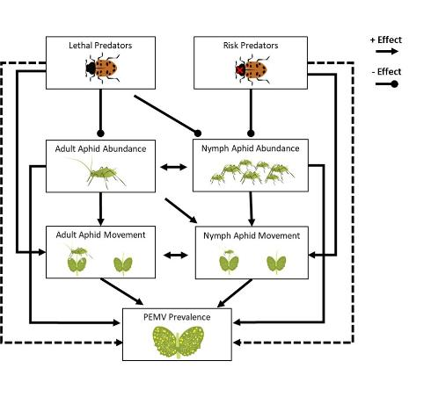
Limitation 9 solution:
Start with an a priori network diagram before you even start data analysis
Lee et al. 2022 examined consumptive and non-comsuptive effects (with complex impacts on aphid abundance and behavior). A diagram made prior became the hypothesis to test with path analysis.

Slide 30
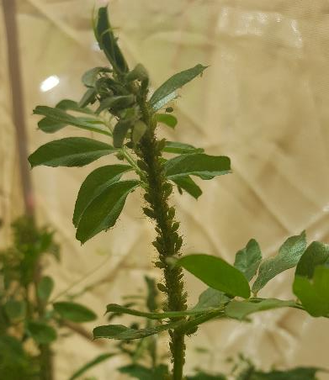
Limitation 10
You cannot run a path model with all connections

Slide 31

Limitation 10 solution: reframe hypothesis about missing pathways

Slide 32
Closing pro-tips
Stick to continuous variables with known relationships whenever possible
Keep your treatment effect hypothesis simple
Give yourself time to create and illustrate and explain figures
Create an a priori diagram in PowerPoint or a dry erase board
Reframe the hypothesis around missing pathways if you are committed to using path analysis

